Slide 1
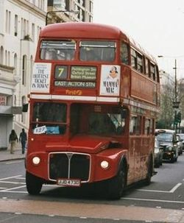
DOUBLE DECKER BUS
NAME: ERIC ZUBERBUHLER

Slide 2
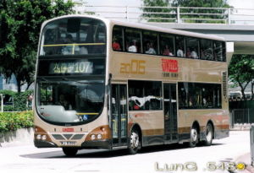
DOUBLE DECKER BUS
A double-decker bus is a bus that has two levels. While double-decker long-distance coaches are in widespread use around the world, double-decker city buses are less common. Double-decker buses are popular in some European cities and in some parts of Asia, usually in former British colonies. Many towns around the world have a few that specialise in short sight-seeing tours for tourists for, as William Gladstone observed, "the way to see London is from the top of a 'bus’”.

Slide 3
HISTORY
In the 1920s, the first engine-powered version of the double-decker bus made its debut in London society. With a growing population, there was a desperate need for more buses, sparking competition amongst the many companies in the city.
The London General Omnibus Company (LGOC), sought to differentiate from their competition and painted their buses bright red. At the time, I doubt anyone could have predicted the historical significance of choosing that one colour.
emand kept up until the 1950s when the most familiar model of the double deckers emerged. The ‘Routemaster,’ was first constructed in 1956. This version had an open rear door entrance, which was quickly removed since people thought they could jump on and off while the bus was moving.

Slide 4
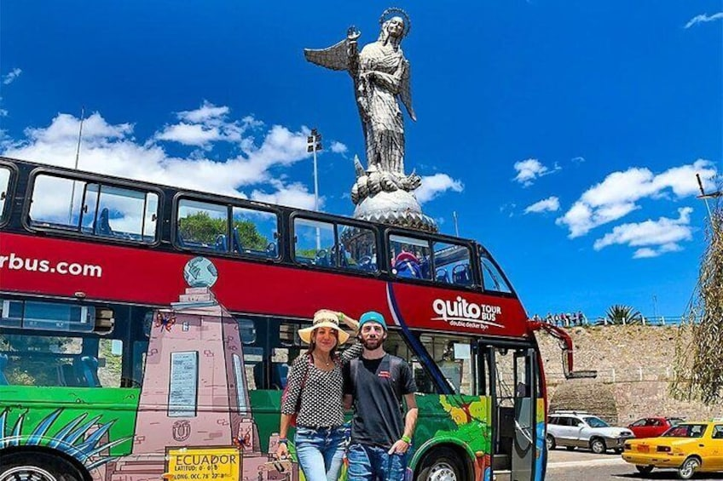
QUITO TOUR BUS
This is a great alternative to get to know the attractions of the north and Old town of the city. At this tour you will see the differents neighbothoods and the main buildings such us: Basilica, San Francisco, Panecillo Virgin, Santa Clara. You will enjoy a stop at Panecillo hill the most important lookout of the city.

